Slide 1

John 3:16 – For God so loved the world, that He gave His only begotten Son, that whosoever believeth in Him should not perish, but have everlasting life.
Genesis 1:1 – In the beginning God created the heaven and the earth.
Notes:
Most Christians will say that they wholeheartedly believe and have even memorized the first verse you see.
But have serious reservations about saying the same for the second…
But John (the same John as the one above) also wrote: “In the beginning was the Word, and the Word was with God, and the Word was God. He was in the beginning with God. All things were made through Him, and without Him nothing was made that was made. In Him was life, and the life was the light of men. And the light shines in the darkness, and the darkness did not comprehend it.”
So, did God create everything or did everything come from nothing?
Big question. Does it matter? Yes. It matters because the Bible is not a book.
It is a collection of books, all of which claim to have been breathed out by God.
So, if God did give us these books and they are incorrect or misleading, then what does that say about God?
If God didn’t give us these books, then from where does their authority come?
Genesis matters because every book of the Bible matters. Can Genesis be trusted in the light of modern science? Great question, let’s look into that a little more.

Slide 2
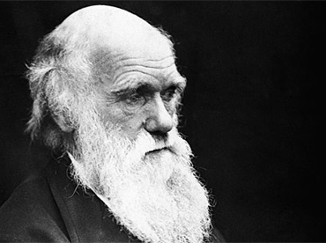
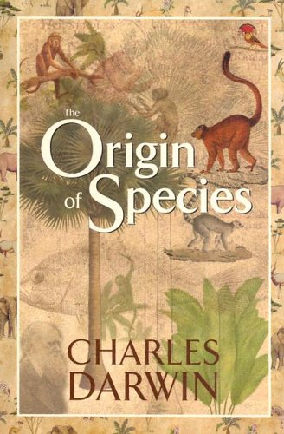
Notes:
Charles Darwin wrote a book. It was wildly popular.

Slide 3
Darwin’s book has caused many changes in the way people think about science, the world, and their place in it.
Notes:
The idea of deep time was actually proposed by Scottish Geologist John Hutton over 100 years before Darwin. Darwin read a book on the subject by Charles Lyell, another Scottish Geologist, before coming up with his theory.
But Darwin’s book was picked up by the non-scientific community and became a culture changing springboard for the hearts and minds of people around the world to jump into the pool of atheism.
Atheism is a worldview that believes that there is no God. Not to be confused with “not believing in God”. Not believing in God is a position of ignorance, while believing that there is no God is a position or stance against God’s existence based on a particular interpretation of evidence or information. It is not scientific, as many claim, it is a faith based system of beliefs. Because it is not rational or repeatable, nor is it observable.

Slide 4
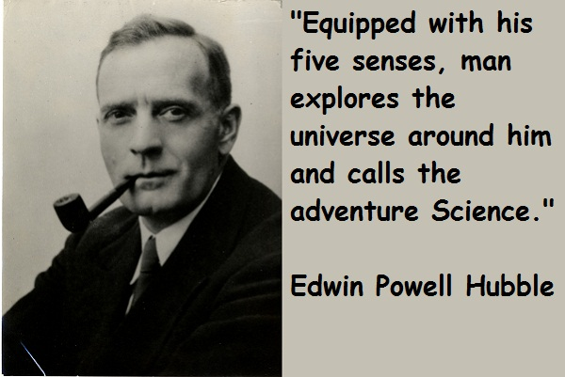
Notes:
Hubble defined science as an exploration. Historical Science can’t be explored. It is based on assumptions shaped by one’s own expectations and worldview.

Slide 5
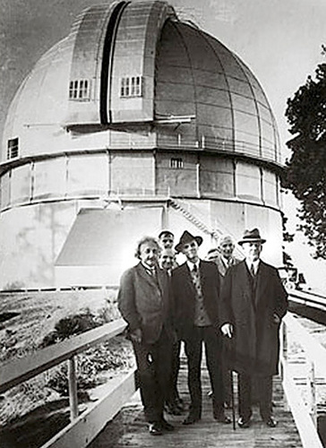
E=mc²
Matter, Space, and Time are related.
Static Universe Theory
Notes:
Einstein’s famous theory states that Time, Space, and Matter are relative to one another, in other words they depend upon one another, so without 1 of them, the other 2 can’t exist.
So all 3 came into existence at the same moment: this point of singularity is creation. The other option is that the universe is eternal. But the 1st and 2nd Laws of Thermodynamics make this an impossibility. Thus, Einstein came up with the Static Universe Theory.

Slide 6
Einstein realized that if time space and matter are tied together then they all must exist in order for any of them to exist. His brain went immediately to where it took Hawking years to arrive.
Notes:
Stephen Hawking worked for years n his collapsing-arc project in which he used mathematics and physics to prove that if the universe is expanding then going back in time would make it shrink or collapse to the point where you would eventually reach a point of ZERO SPACE, which would not allow for matter to exist, nor for time to exist if these are all relative.

Slide 7
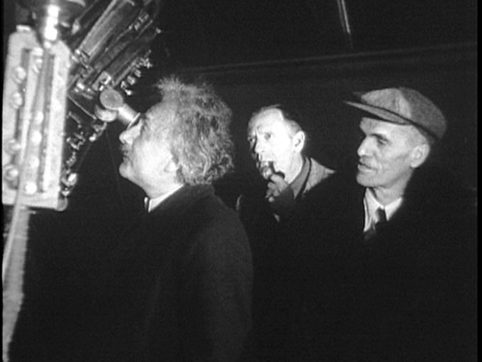
“I now see the need for a beginning.”
Notes:
Edwin Hubble took Einstein into his observatory and Einstein looked through a hubble telescope and saw evidence of an expanding universe and said, “I now see a need for a beginning.”
But when, and where, and how did it all begin?

Slide 8

Notes:
Some modern scientists would have you to believe that they can explain creation without God, but they can’t. Honest scientists, even those who don’t believe in God, will tell you that there must have been a supernatural event at some point in history. Thus, Genesis 1 and John 1…
The universe could not possibly exist without a powerful, transcendent, intelligent creator deciding to act.
So, does science prove the Bible is true? No, scientific study has guided the process by which we have scientific or physical laws known as Physics. These Laws prove that the Universe has a supernatural origin. This is explained in the Bible… and no where else.
So, what about Darwin’s theory of the origin of species? It is pure speculation and it leaves out the most important aspect of the question. It just skips right over it as if it didn’t matter… The origin of LIFE.
Most people don’t ask the question because they think they know the answer, but they don’t. They have an illusion of knowledge, which keeps them from true knowledge.

Slide 9
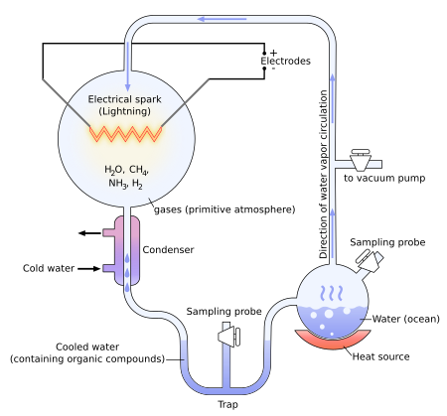
Notes:
The Miller-Urey Experiment – 1953 An explanation of how compounds could have formed millions of years ago. Leading to more and more complex compounds such as amino acids, proteins, RNA, DNA, and eventually living organisms.
Problems: According to Scott M. Huse, Ph.D.’s “The Collapse of Evolution,” page 153:
1. The concentrations of methane and ammonia were carefully selected to ensure the production of organic molecules. There is no evidence to suggest the Earth’s atmosphere was so characterized.
2. There is no evidence to indicate the Earth’s early atmosphere was reducing. There is, however, considerable evidence to suggest the Earth had an oxidizing atmosphere during most, if not all, of its history.
3. A methane-ammonia-reducing atmosphere would be fatal to life-forms.
4. The simulation of lightning by mild spark discharges is unrealistic. Actual lightning would have destroyed any organics that may have been present.
5. The molecules produced in the Miller-Urey apparatus would react detrimentally to life forms that were trying to evolve. Chemically, they would destroy all hope of producing life.
The other problems with the experiment are as follows:
1. They cheated. They designed the apparatus to separate amino acids from the mix once they were formed. If they hadn’t done that as soon as an amino acid was formed, the next electrical spark may have rearranged the atoms into some other form.
2. The amino acids they did produce were half left-handed and half right-handed, just like you would expect from a random process like electrical sparks in a gas mixture. The trouble is, only left-handed amino acids are used in organisms.
3. Additional molecules were formed other than amino acids. Namely, formaldehyde and cyanide, which are destructive to life.
So, the origin of life is a tough question in the absence of Genesis 2:7.
More problems has come up as we have learned more about DNA as well.

Slide 10
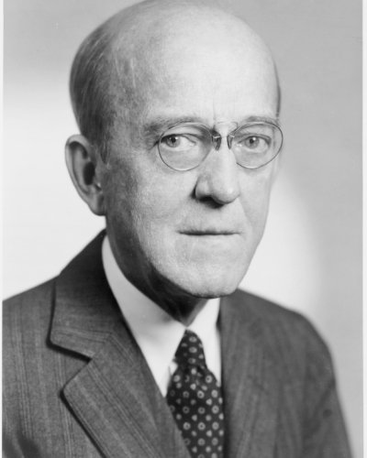
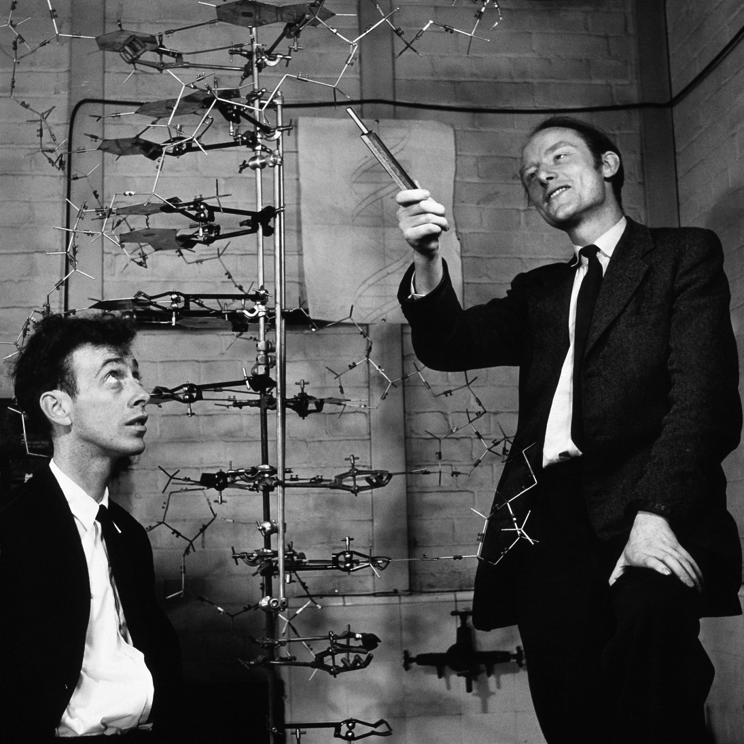
In 1943, Oswald Avery was able to prove that DNA carried genetic information.
In 1952, Watson and Crick at Cambridge University discovered the Double Helix structure of DNA.
Notes:
These happened before Miller-Urey but the information was still very limited at the time.

Slide 11
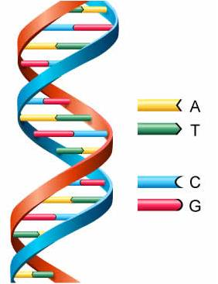
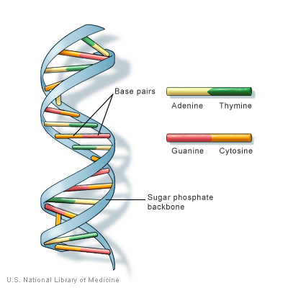
Notes:
DNA is an incredibly complex arrangement of nucleobases in a double helix formation which carries the information necessary for all forms of life.
Guanine only bonds with cytosine, and thymine only bonds with adenine. Yet all of the information used in your development is written with these nucleobases in your particular DNA.
Life is way more complicated and DNA far more complex than we ever thought back in the 50’s and we still don’t know everything about it. To imagine this developed over time by natural processes is akin to believing that a dead man locked in an airtight capsule could write all the works of Shakespeare without a writing utensil, paper, or the existence of language. It is impossible, regardless of how much time you allow for it to happen.
The amount and type of information communicated through DNA must have an intelligent author.
So, does science prove the Bible is true? No, scientific study has guided the process by which we have scientific or physical laws, known as Biology. These Laws prove that Life has a supernatural origin.
Thus, we need to look at things in a different way. We can’t always understand the past by examining the present. Sometimes we must trust eyewitness accounts of what happened. This is the case with the origin of the universe and the origin of life.
There was only one eyewitness to these events: God.
Genesis 1 & 2, John 1, as well as Job, Exodus, Psalms, Isaiah, etc. tell us that what Paul wrote in Romans 1:18-23.
So, does Genesis matter? Yes.
Can I honestly and judiciously say that I believe it? Yes.

